Slide 1
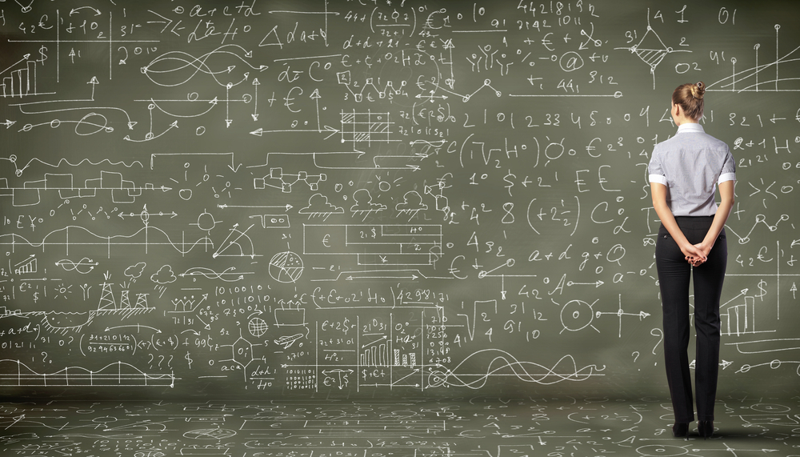
A (Very) Brief Introduction to Machine Learning and its Application to Mobile Networks
David Meyer
SP CTO and Chief Scientist
Brocade
dmm@brocade.com

Slide 2
Agenda
Goals for this Talk
Automation Continuum
Software Defined Intelligence
Architecture and Pipeline
What is Machine Learning?
Mobile Use Case(s)
Appendix: How can machine learning possibly work?

Slide 3
Goals for this Talks
To give us a basic common
understanding of Machine Learning
and Software Defined Intelligence
so that we can discuss their
application to Carrier Mobile use
cases.

Slide 4
Agenda
Goals for this Talk
Automation Continuum
Software Defined Intelligence
Architecture and Pipeline
What is Machine Learning?
Mobile Use Case(s)
Appendix: How can machine learning possibly work?

Slide 5
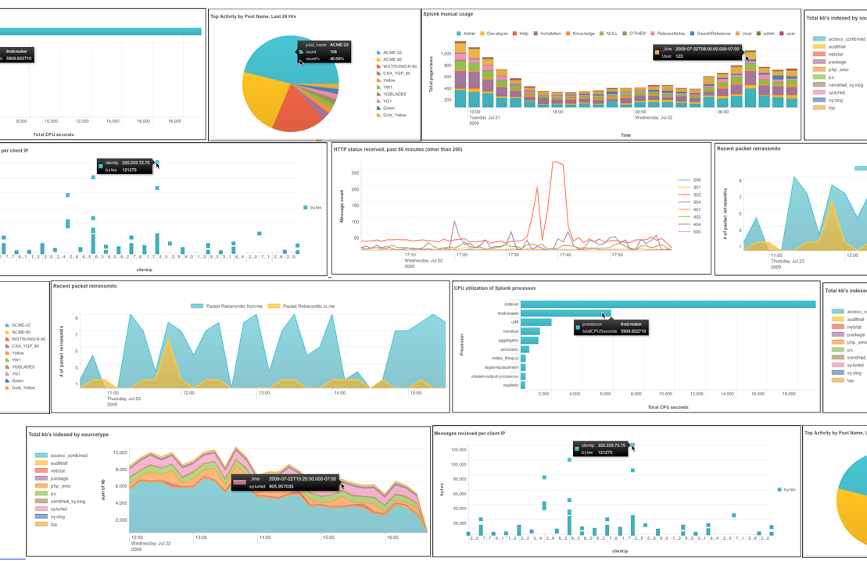
Brief Overview of Analytics Use Cases

Slide 6
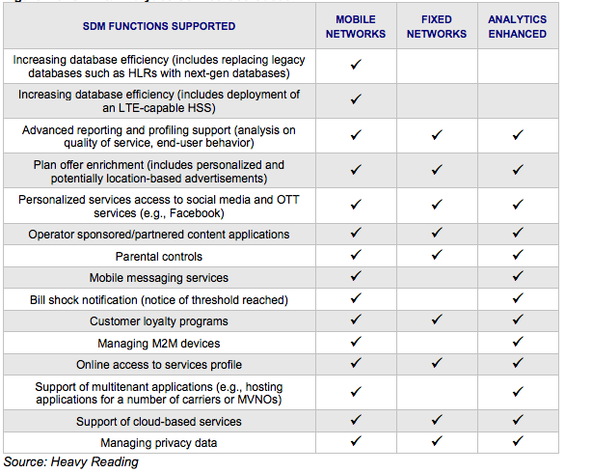
SDM and Analytics Use-Cases

Slide 7
Segmentation and Hierarchy of Analytics
Analytics can be looked at in multiple segments
Historical Analytics: Build data warehouses / run batch queries to predict future events / generate trend reports
Near Real-Time Analytics: Analyze indexed data to provide visibility into current environment / provide usage reports
Real-Time Analytics: Analyze data as it is created to provide instantaneous, actionable business intelligence to affect immediate change
Predictive Analytics: Build statistical models that can classify/predict the near future
Each segment of analytics serves specific purposes
Historical Analytics: Campaign & service plan creation, network planning, subscriber profiling, customer care
Near Real-time Analytics: Network optimization, new monetization use-cases, targeted services (ex. Location-based)
Real-time Analytics: Dynamic policy, self-optimizing networks, traffic shaping, topology change, live customer care
Data is richer when associated to context – location, time of day, etc.
For each type of data, there is a window / meaningful time period of which the data is relevant
“Right time” or “timeliness” is a consideration to the query itself, not the data set
In mobile, the “window of relevance” of contextual data is consistently shrinking

Slide 8
The Network and Big Data
So…the network is evolving into a source of data for analytics
Utilization, performance, security data, …
Traffic – what is crossing the network?
Browsing
Applications
The network is evolving as a transport of data for analytics
M2M
Not location bound, distributed over many points of network attachment
In many cases data will be write once, read many to support a variety of analytics processes
Access to data via distributed compute/analytics
Access to data via distribution of the data

Slide 9
What types of “big data” are out there?
Profile
Profiling
Device sensor data
Persistent Location / Presence
Behavioral / Search / Social
Purchasing / Payments
Mobility patterns
Usage data (from device)
Identity (Persistent)
Demographics
Explicit profile (interests, etc.)
Device(s) and capabilities
Billing / Subscription plan
User
Analytics
Catalog / Title
Topic / Keywords
CA / Rights management
Encryption / DRM
Format(s) / Aspect ratio(s)
Resolution(s) / Frame rate(s)
Consumption data
Content reach
Asset popularity / revenue
Distribution/Retention/Archival
Search / Discover / Recommend
Usage Data (from content source)
Content
Analytics
Bandwidth and latency
Access types
IP pools
Routes / topology / Path
QoS / Policy Rulesets
Network Service Capabilities
Active subscriber demographics
Crowdsourced data
Geographic segmentation
Network Performance / Quality
Network sensor data (IoT/M2M)
Usage (from DPI)
Network
Analytics
Slide courtesy Kevin Shatzkamer

Slide 10
Automation Continuum
While customers today have a broad range of network management approaches, nearly all struggle to understand how to reach their goal of a fully automated and dynamic architecture.
Machine Learning
Average Customer
Industry Pioneers
CONTROLLER-BASED ARCHITECTURE
CLI
CLI SCRIPTING
Manual
Automated/Dynamic
CLI
AUTOMATION
Machine
Intelligence
INTEGRATION
PROGRAMMABILITY
DEVOPS / NETOPS
ORCHESTRATION
Original slide courtesy Mike Bushong and Joshua Soto
Notes:
Most customers are at the very early side of this continuum of maturity when it comes to automating the network. They may have a couple of expect scripts, some MOPs and SOPs, but things are not really automated in any really meaningful way. They don’t have any sort of control framework or controller, not using OpenStack, not interested in programmability. Most want the network to be easier to manage.
Companies such as Netflix, are at the furthest end of the spectrum using a much more fully integrated Dev/NetOps approach
Our job is not to paint a picture of our customer’s full operational maturity, our job is to show them that we know what full operational maturity looks like and then get them further down the continuum in that direction.
Present in the industry today is a huge separation between where customers are today and the “vision” that everyone is talking about.
Your role as a sales person, is to be the TRUSTED ADVISOR that doesn’t judge the customer for where they are, but can identify their current pain point and point to a path to full operational maturity over the next several years.
Mike’s analogy for a 22hr treadmill session

Slide 11
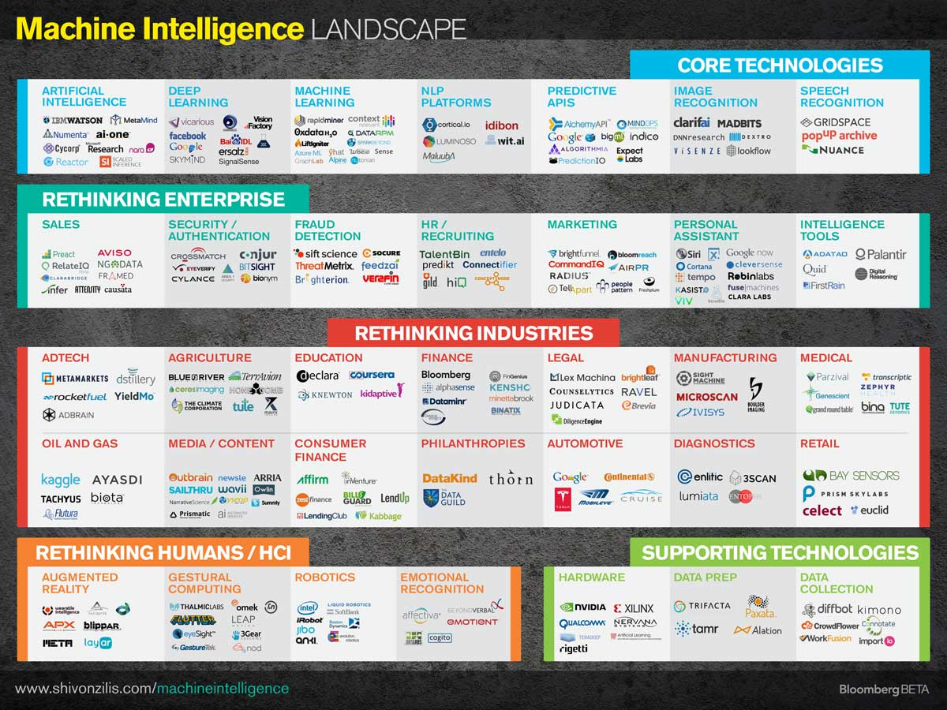

Slide 12
Agenda
Goals for this Talk
Automation Continuum
Software Defined Intelligence
Architecture and Pipeline
What is Machine Learning?
Mobile Use Case(s)
Appendix: How can machine learning possibly work?

Slide 13






Software Defined Intelligence
Architecture Overview
Domain Knowledge
Domain Knowledge
Domain Knowledge
Domain Knowledge
Brocade and 3rd party Applications
Analytics Platform
Learning
Presentation Layer
Intelligence
Data Collection
Packet brokers, flow data, …
Preprocessing
Big Data, Hadoop, Data Science, …
Model Generation
Machine Learning
Oracle
Model(s)
Remediation/Optimization/…
Oracle
Logic
Oracle Logic Example (PCRF pseudo-code)
If (predict(User, X, eMBS)):
switch2eMBS(User)
Where X = (Mobility patterns, cell size, data plan,
weighted popularity of content, # of channels, …)
Topology, Anomaly Detection,
Root Cause Analysis,
Predictive Insight, ….

Slide 14





What Might a Mobile Analytics Platform Look Like?
Think “Platform”, not Applications, Algorithm, Visualization
Brocade / 3rd Party Applications
Service Provider Use-Cases
SON
PCRF
SDN
Controller
NFV-O
Index / Schema
(Metadata Mgmt)
Operations
Marketing
Cust. Care
NW Planning
Security
Distributed Data Management
(Pre-filtering, aggregation, normalization (time / location), distribution)
Big Data Management
(Correlation, trend analysis, pattern recognition)
Data Collection (Push) / Extraction (Pull)
(RAN, IPBH, LTE EPC, Gi LAN, IMS, Network Services, OSS)
Direct API
Tap / SPAN
PCRF
IMS
SDN Svc Chain
eNB
vEPC
DPI
NAT
CSR
Aggregation
Router
IP Edge
Internet
RAN
Video Opt.
App Proxy
Gi LAN Services
Slide courtesy Kevin Shatzkamer

Slide 15
Agenda
Goals for this Talk
Automation Continuum
Software Defined Intelligence
Architecture and Pipeline
What is Machine Learning?
Mobile Use Case(s)
Appendix: How can machine learning possibly work?

Slide 16
Before We Start What is the SOTA in Machine Learning?
“Building High-level Features Using Large Scale Unsupervised Learning”, Andrew Ng, et. al, 2012
http://arxiv.org/pdf/1112.6209.pdf
Training a deep neural network
Showed that it is possible to train neurons to be selective for high-level concepts using entirely unlabeled data
In particular, they trained a deep neural network that functions as detectors for faces, human bodies, and cat faces by training on random frames of YouTube videos (ImageNet¹). These neurons naturally capture complex invariances such as out-of-plane rotation, scale invariance, …
Details of the Model
Sparse deep auto-encoder (catch me later if you are interested in auto-encoders)
O(10⁹) connections
O(10⁷) 200x200 pixel images, 10³ machines, 16K cores
→ Input data in R⁴⁰⁰⁰⁰
Three days to train
15.8% accuracy categorizing 22K object classes
70% improvement over current results
Random guess achieves less than 0.005% accuracy for this dataset
Andrew Ng and his crew at Baidu have recently beat this record with their
(GPU based) Deep Speech work. See http://arxiv.org/abs/1412.5567
1 http://www.image-net.org/

Slide 17
What is Machine Learning?
The complexity in traditional computer programming is in the code (programs that people write). In machine learning, algorithms (programs) are in principle simple and the complexity (structure) is in the data. Is there a way that we can automatically learn that structure? That is what is at the heart of machine learning.
-- Andrew Ng
That is, machine learning is the about the construction and study
of systems that can learn from data. This is very different than
traditional computer programming.

Slide 18
The Same Thing Said in Cartoon Form
Traditional Programming
Machine Learning
Data
Computer
Output
Program
Data
Computer
Program
Output

Slide 19
When Would We Use Machine Learning?
When patterns exists in our data
Even if we don’t know what they are
Or perhaps especially when we don’t know what they are
We can not pin down the functional relationships mathematically
Else we would just code up the algorithm
When we have lots of (unlabeled) data
Labeled training sets harder to come by
Data is of high-dimension
High dimension “features”
For example, sensor data
Want to “discover” lower-dimension representations
Dimension reduction
Aside: Machine Learning is heavily focused on implementability
Frequently using well know numerical optimization techniques
Lots of open source code available
See e.g., libsvm (Support Vector Machines): http://www.csie.ntu.edu.tw/~cjlin/libsvm/
Most of my code in python: http://scikit-learn.org/stable/ (many others)
Languages (e.g., octave: https://www.gnu.org/software/octave/)

Slide 20
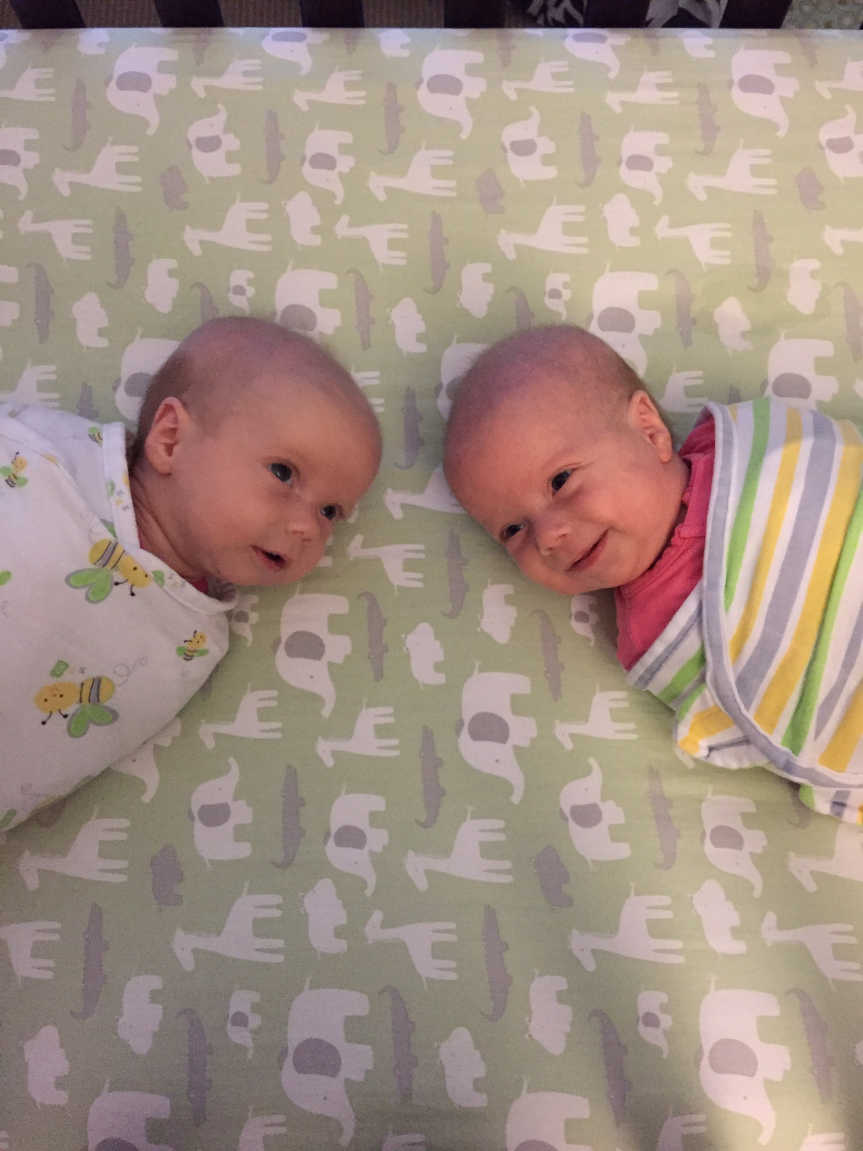
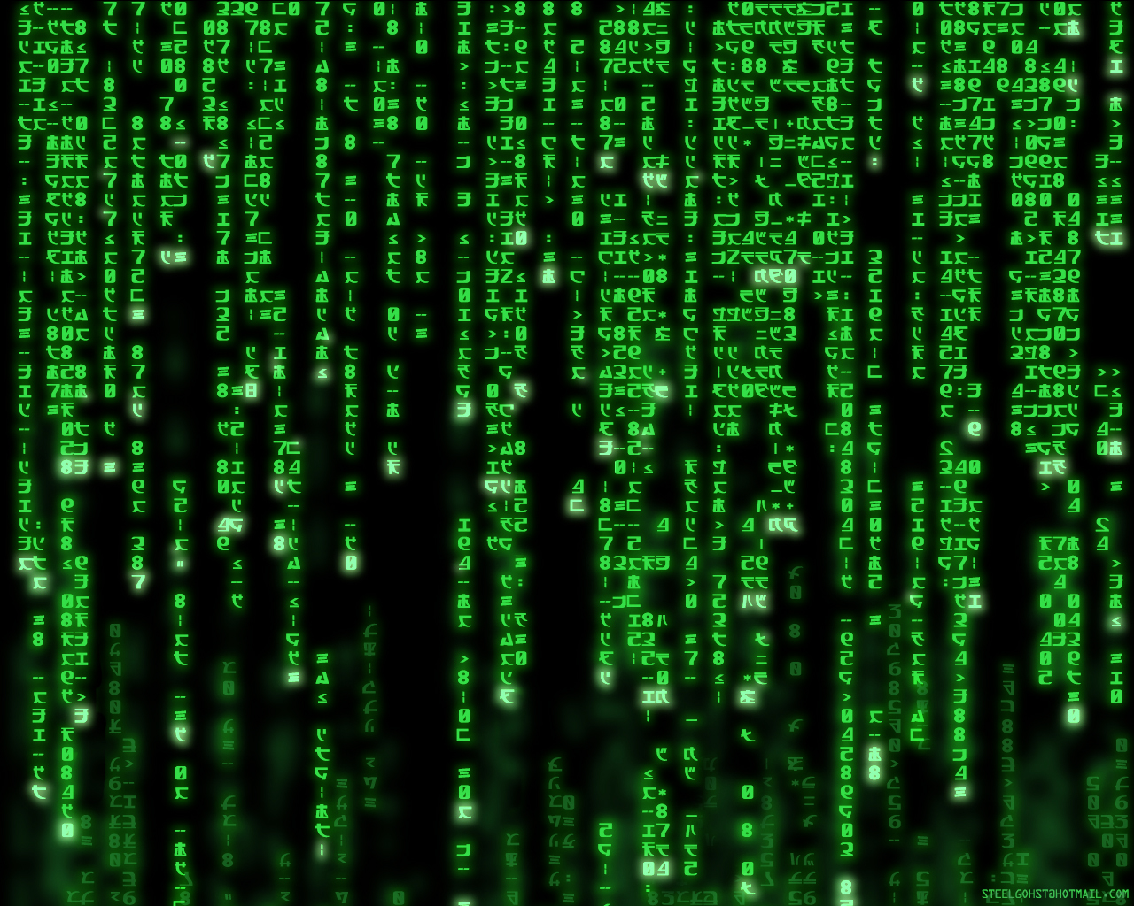
Why Machine Learning is Hard
You See
Your ML Algorithm Sees

Slide 21
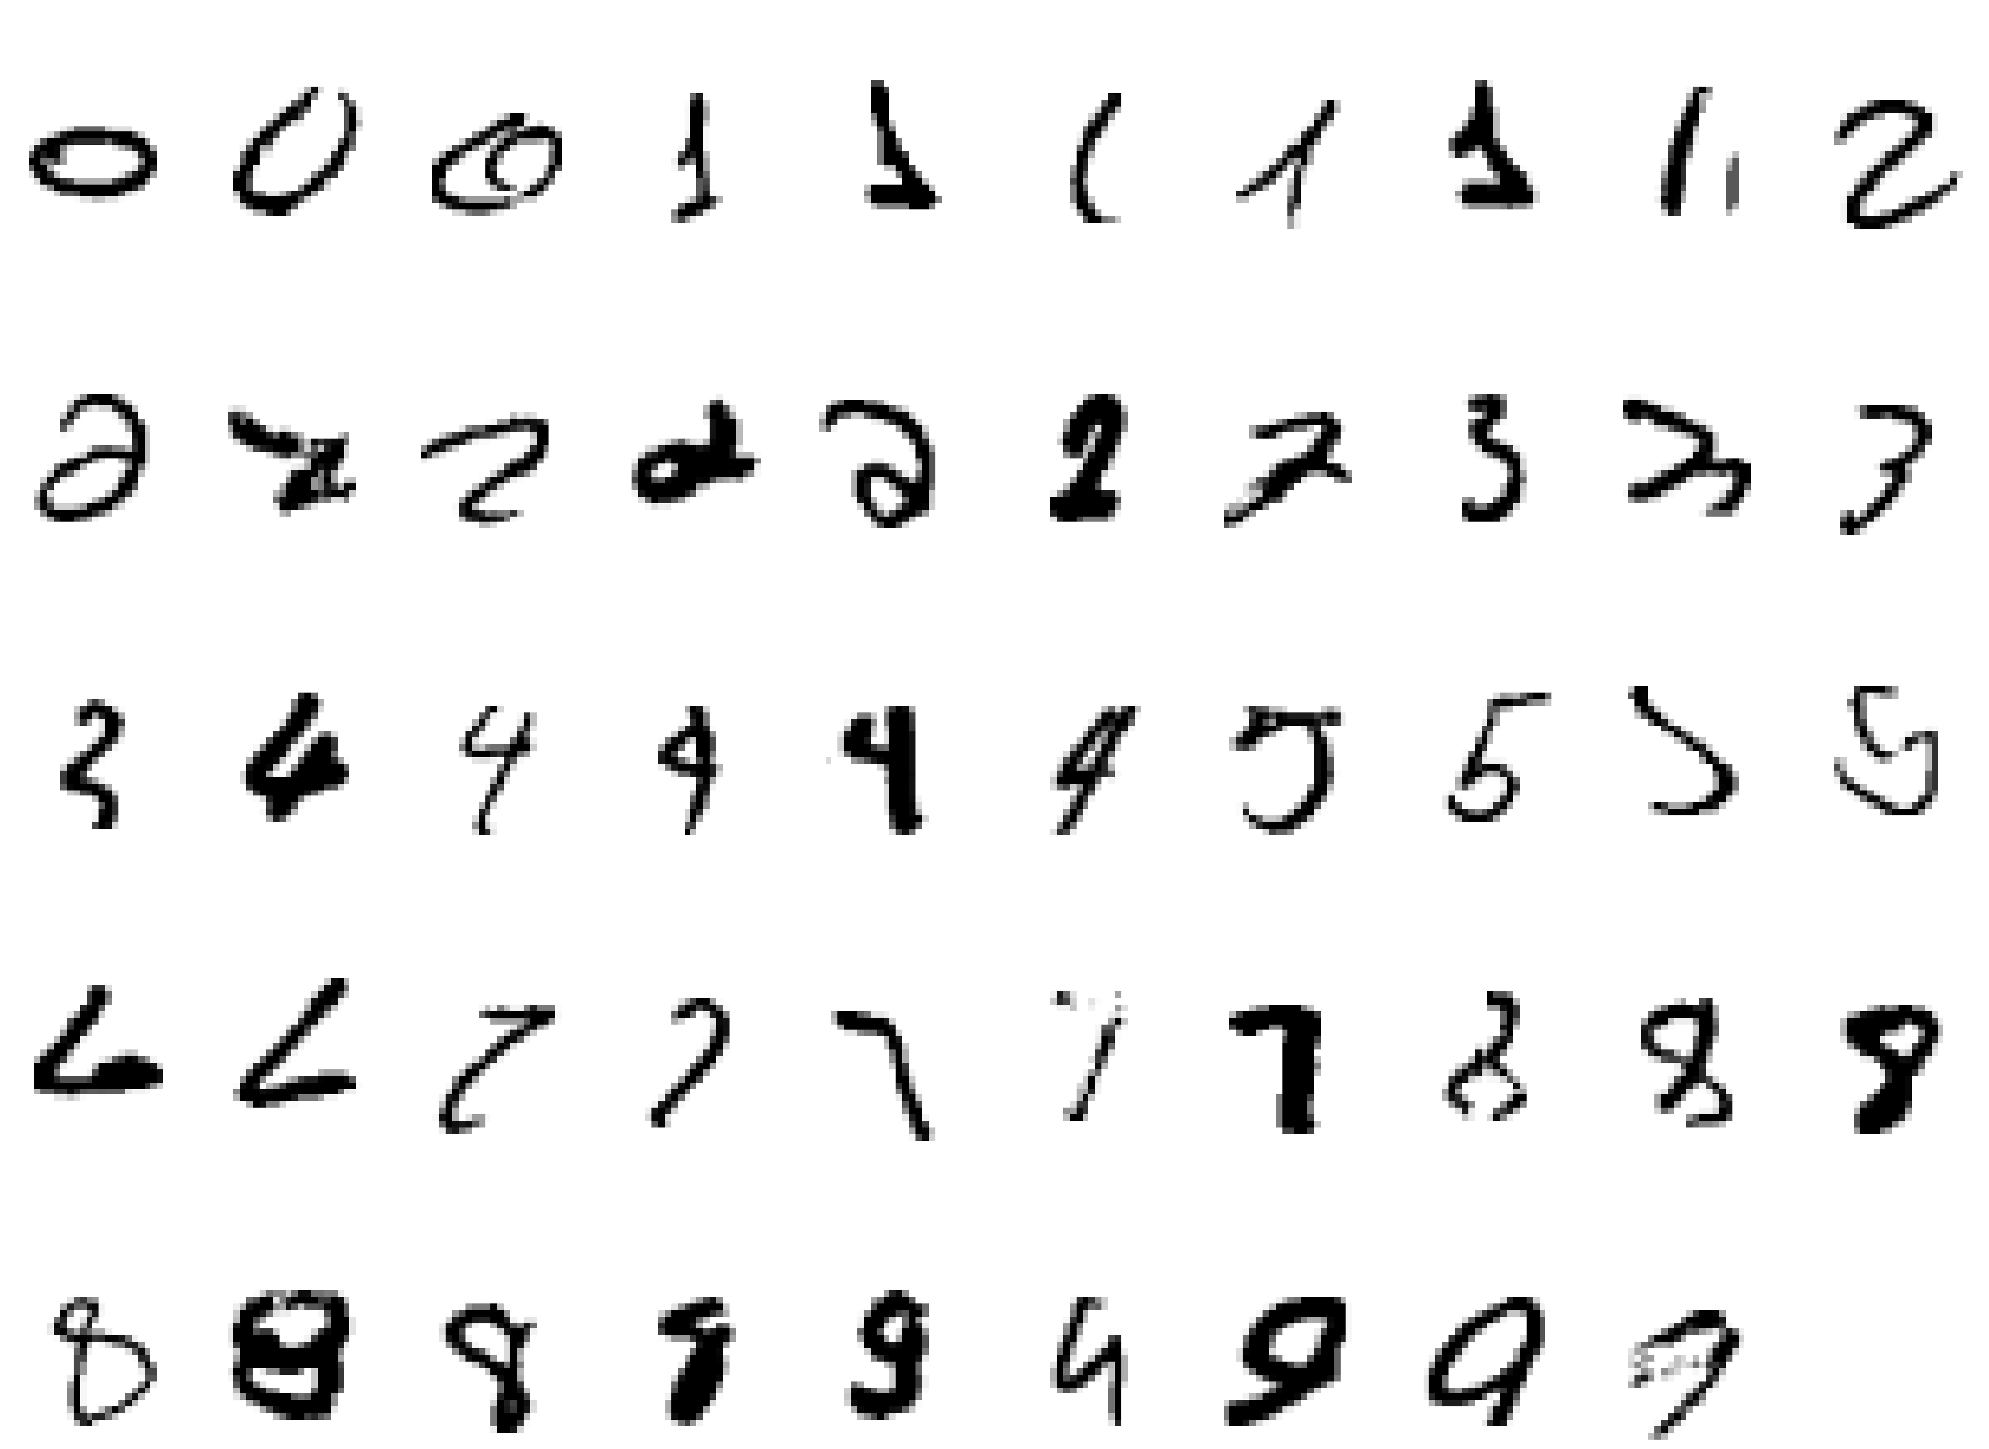
Why Machine Learning Is Hard, Redux What is a “2”?

Slide 22
Examples of Machine Learning Problems
Pattern Recognition
Facial identities or facial expressions
Handwritten or spoken words (e.g., Siri)
Medical images
Sensor Data/IoT
Optimization
Many parameters have “hidden” relationships that can be the basis of optimization
Pattern Generation
Generating images or motion sequences
Anomaly Detection
Unusual patterns in the telemetry from physical and/or virtual plants (e.g., data centers)
Unusual sequences of credit card transactions
Unusual patterns of sensor data from a nuclear power plant
or unusual sound in your car engine or …
Prediction
Future stock prices or currency exchange rates

Slide 23
Machine Learning is a form of Induction
Given examples of a function (x, f(x))
Supervised learning (because we’re given f(x))
Don’t explicitly know f
Rather, trying to learn f from the data
Labeled data set (i.e., the f(x)’s)
Training set may be noisy, e.g., (x, (f(x) + ε))
Notation: (x_{i}, f(x_{i})) denoted (x^{(i)},y^{(i)})
y^{(i)} sometimes called t_{i} (t for “target”)
Predict function f(x) for new examples x
Discrimination/Prediction (Regression): f(x) continuous
Classification: f(x) discrete
Estimation: f(x) = P(Y = c|x) for some class c

Slide 24
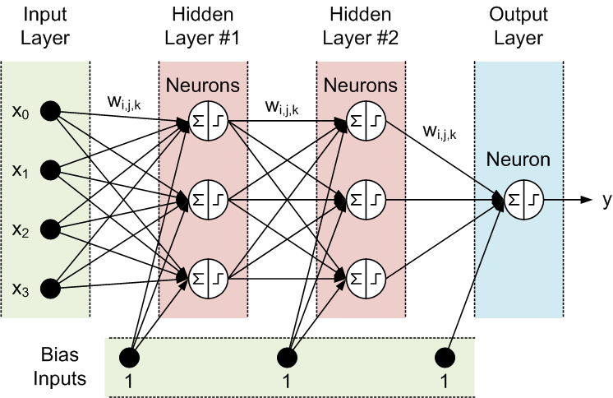
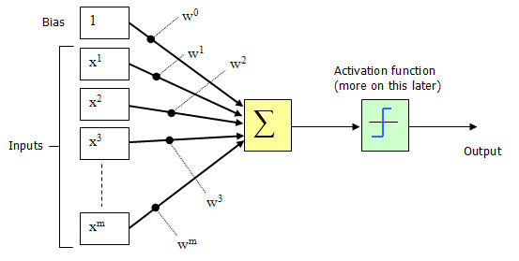
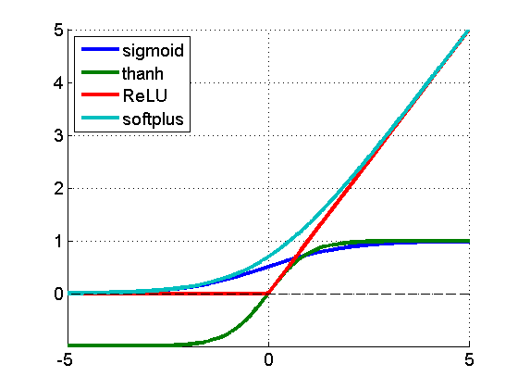
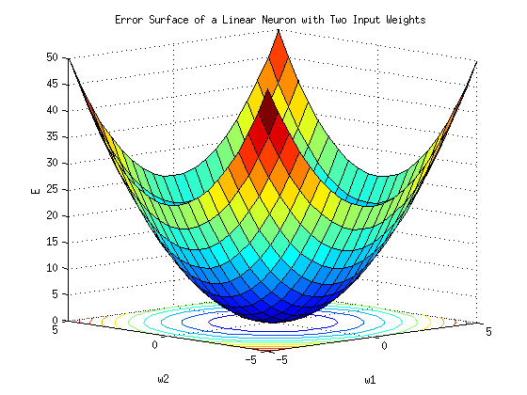
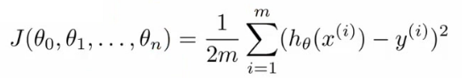
Deep Feed Forward Neural Nets (in 1 Slide (☺))
(x^{(i)},y^{(i)})
h_{θ}(x^{(i)})
Where do the weights come from?
hypothesis
So what then is learning?
Learning is adjusting the w_{i,j}’s such that the cost
function J(θ) is minimized (a form of Hebbian learning)

Slide 25
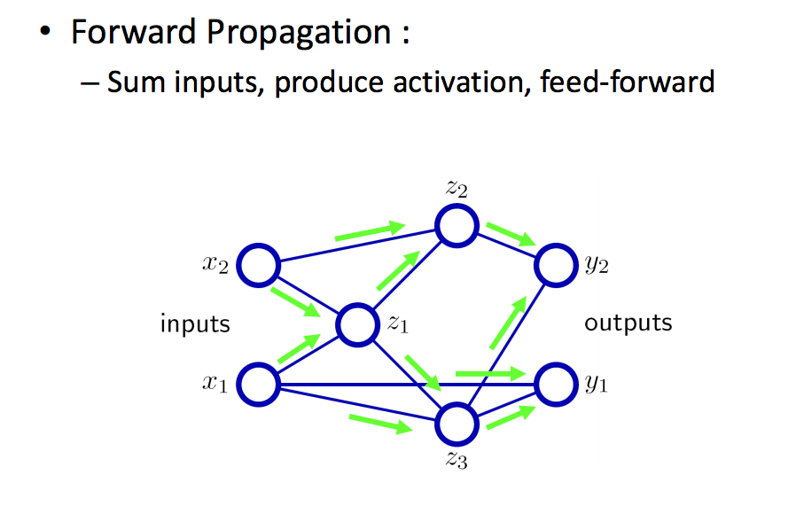
Forward Propagation Cartoon

Slide 26
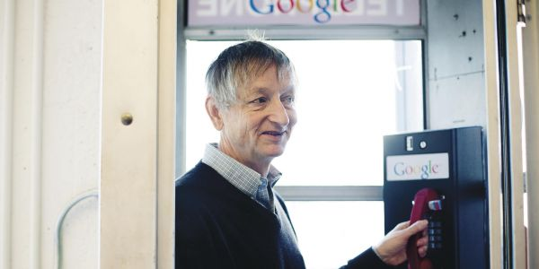
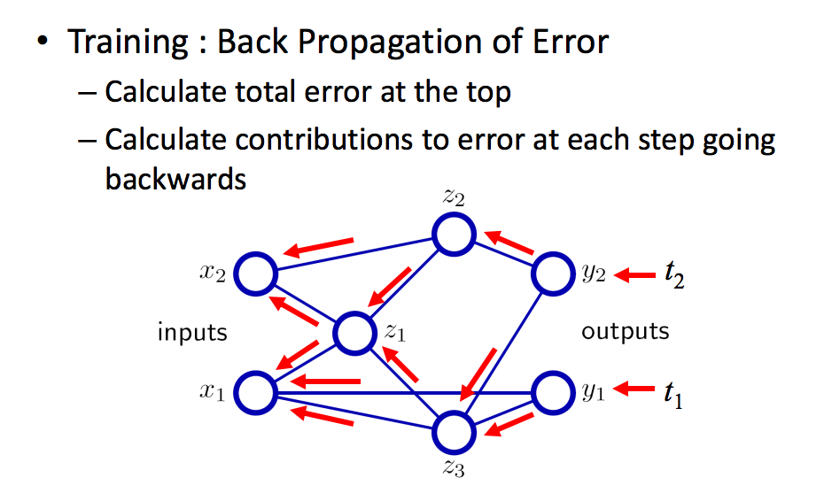
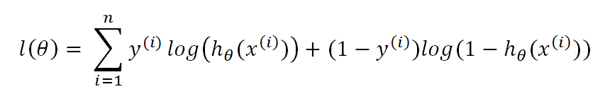
Backpropagation Cartoon
http://chronicle.com/article/The-Believers/190147

Slide 27
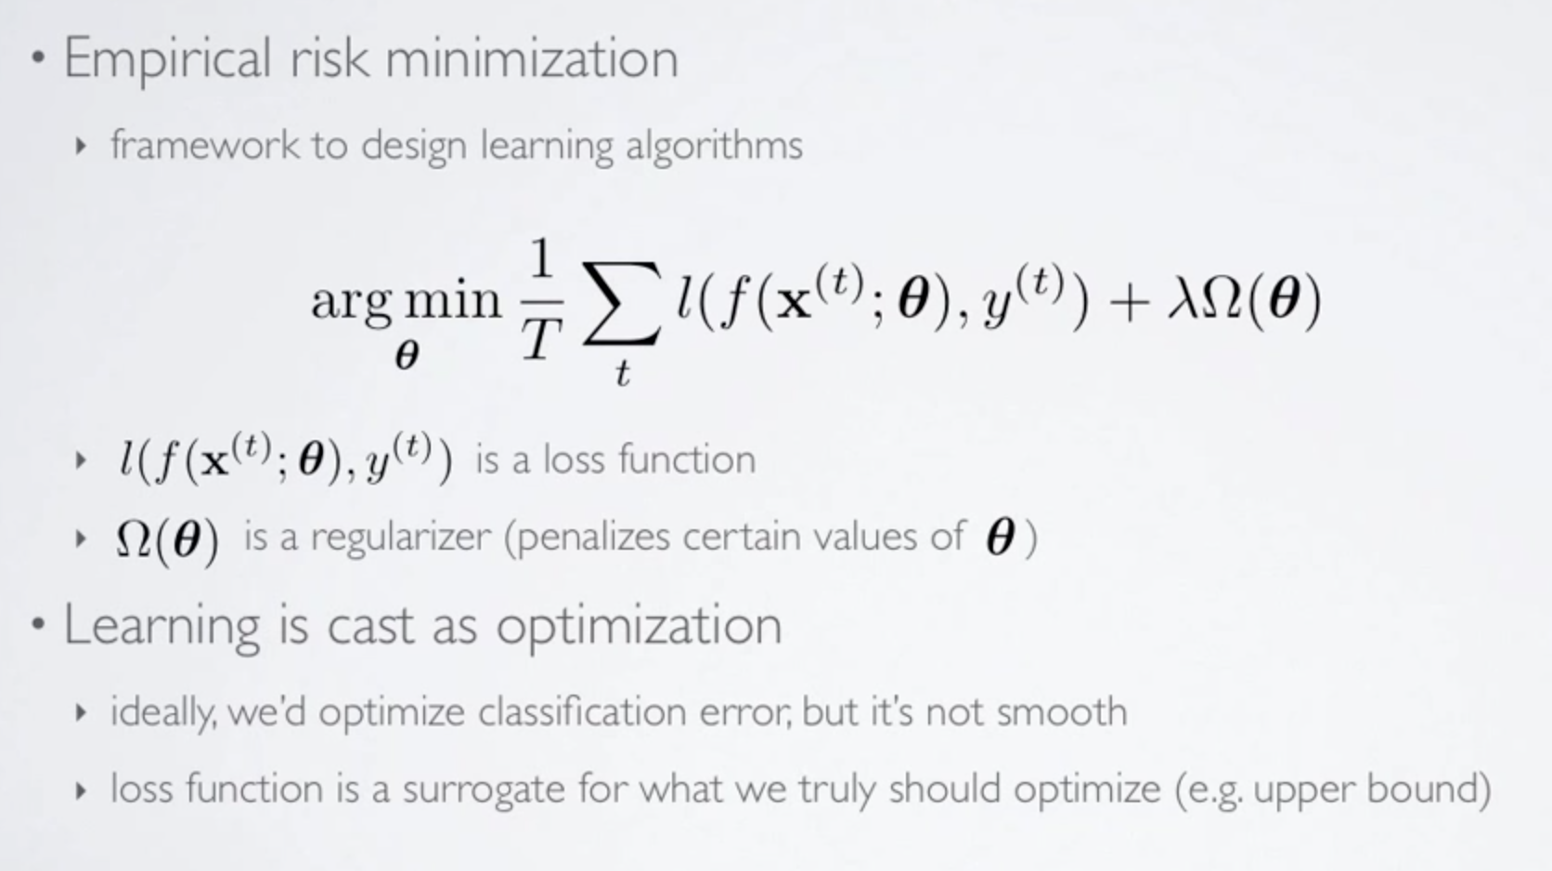
More Formally Empirical Risk Minimization
(loss function also called “cost function” denoted J(θ))
Any interesting cost function is complicated and non-convex

Slide 28
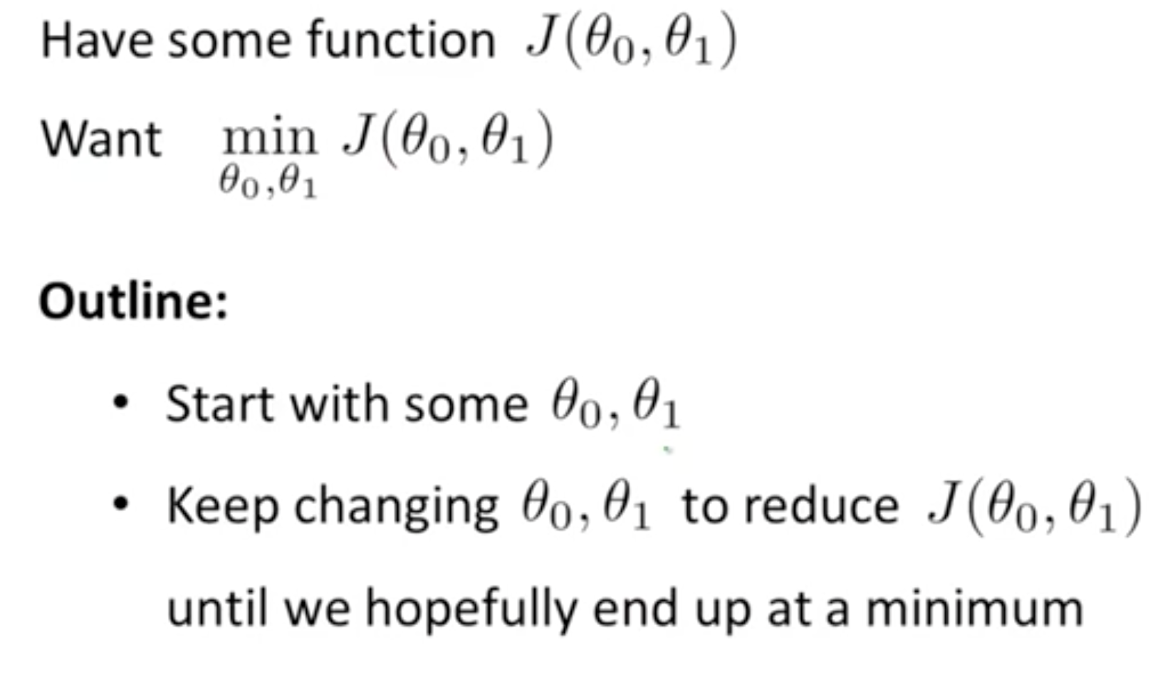
Solving the Risk (Cost) Minimization Problem Gradient Descent – Basic Idea

Slide 29
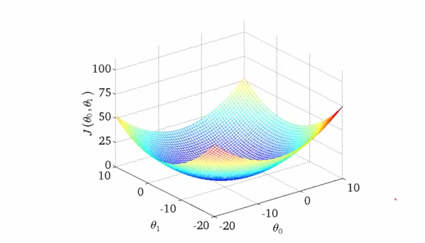
Gradient Descent Intuition 1 Convex Cost Function
One of the many nice properties of
convexity is that any local minimum
is also a global minimum

Slide 30
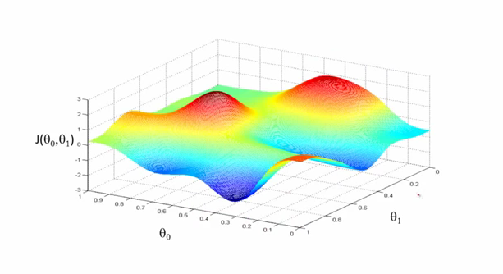
Gradient Decent Intuition 2
Unfortunately, any interesting cost function is likely non-convex

Slide 31
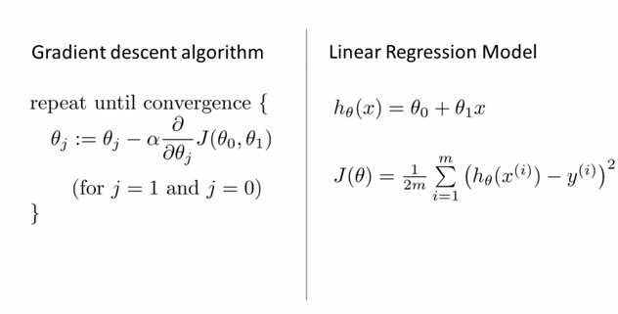
Solving the Optimization Problem Gradient Descent for Linear Regression
The big breakthrough in the 1980s from the Hinton lab was the backpropagation
algorithm, which is a way of computing the gradient of the loss function with
respect to the model parameters θ

Slide 32
Agenda
Goals for this Talk
Automation Continuum
Software Defined Intelligence
Architecture and Pipeline
What is Machine Learning?
Mobile Use Case(s)
Appendix: How can machine learning possibly work?

Slide 33
Now, How About Mobile Use Cases?
Mobile ideally suited to SDN and Machine Learning
Can we infer properties of paths/equipment/users we can’t directly see?
Likely living in high-dimensional space(es)
i.e., those in other domains
Other inference tasks?
Aggregate bandwidth consumption
Most loaded links/congestion
Cumulative cost of path set
Uncover unseen correlations that allow for new optimizations
How to get there from here
Applying Machine Learning to the Mobile spacerequires understanding the problem you want to solve and what data sets you have

Slide 34
A Future State Mobile Architecture
NFV-O
Analytics
MME
SGW-C
PGW-C
HSS
OFCS
OCS
PCRF
DPI
NAT
Video
Opt.
3rd
Party
SON
IMS
Subscriber Information Base (Shared Session State Database)
SDN Controller
eNB
S1-MME
SGi
IPv6
Internet
RAN
S1-U
SGi
CSR
Control Functions Integrated into NFV, Bearer Functions Integrated into SDN
Enhanced NB and SB APIs in SDN Controller
SGW-C and PGW-C maintain 3GPP-compliant external interfaces (S1-U, S5, S11, SGi, S7/Gx, Gy, Gz)
Integrated Security (Firewall, NAT), removal of physical boundary constraints
Session State Convergence: Subscriber Management delivered via shared columnar/hybrid database
Integrated SON + SDN + NFV-O for Radio + Network + Datacenter policy convergence
Open APIs (Database, Controller, Orchestrator) for 3rd Party Applications
Slide courtesy Kevin Shatzkamer

Slide 35
A Few Principles of Future Mobile Architectures
Elastic (for the variance)
Access: Baseband Processing (Cloud RAN), RAN Controllers (Cloud Controllers) Core: Evolved Packet Core, Video Optimization, Deep Packet Inspection, NAT, Firewall, VPN Services: VoLTE/IMS, Video, CDN, Policy, Identity SDP: APIs, M2M Hardware-independence + Virtualization + VM Mobility
Scalable (for the aggregate)
Highly distributed bearer plane Independent control plane (inline or centralized) Policy + Orchestration = Subscriber + Resource Optimization
Dynamic (Evolving to Self-Organizing)
Big data analytics models unpredictability in Aggregates and Variances Dynamic decisions (manual or automatic intervention) based on analytics Adaptable routing/forwarding decisions that follow mobility events (subscribers, content, identity, services, applications, virtual machines)
Cost-Effective (OPEX and CAPEX)

Slide 36
Mobile Data Sets
Assume we have labeled data set
{(X⁽¹⁾,Y⁽¹⁾),…,(X^{(n)},Y^{(n)})}
Where X^{(i)} is an m-dimensional vector, and
Y^{(i)} is usually a k dimensional vector, k < m
Strawman X (the network has this information, and much much more)
X^{(i)} = (Path end points,
Desired path constraints,
Signal impairment,
Computed path,
Aggregate path constraints (e.g. path cost),
Minimum cost path,
Minimum load path,
Maximum residual bandwidth path,
Aggregate bandwidth consumption,
Load of the most loaded link,
Cumulative cost of a set of paths,
(some measure of buffer occupancy),
…,
Other (possibly exogenous) data)
If we have Y^{(i)}’s are a set of classes we want to predict, e.g., congestion, latency, …

Slide 37
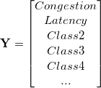
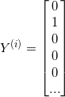
What Might the Labels Look Like? (sparseness)
→
(instance)

Slide 38
Making this Real (what do we have to do?)
Choose the labels of interest
What are the classes of interest, what might we want to predict?
Get the data sets (this is always the “trick”)
Labeling?
Split into training, test, cross-validation
Avoid generalization error (bias, variance)
Avoid data leakage
Choose a model
I would try supervised DNN
We want to find “non-obvious” features, which likely live in high-dimensional space
Write code
Then write more code
Test on (previously) unseen examples
Iterate

Slide 39
Issues/Challenges
Is there a unique model that Mobile Oracles would use?
Unlikely → online learning
Ensemble learning, among others
Mobile is a non-perceptual tasks (we think)
Does the Manifold Hypothesis hold for non-perceptual data sets?
Seems to (Google PUE, etc)
Unlabeled vs. Labeled Data
Most commercial successes in ML have come with deep supervised learning → labeled data
We don’t have ready access to large labeled data sets (always a problem)
Time Series Data
With the exception of Recurrent Neural Networks, most ANNs do not explicitly model time (e.g., Deep Neural Networks)
Flow data/sampling
Training vs. {prediction,classification} Complexity
Stochastic (online) vs. Batch vs. Mini-batch
Where are the computational bottlenecks, and how do those interact with (quasi) real time requirements?

Slide 40
Q & A (or we can take a look at how ML could possibly work)
Thanks!

Slide 41
How Can Machine Learning Possibly Work?
We want to build statistical models that generalize to unseen cases
What assumptions do we need to do this (essentially predict the future)?
4 main “prior” assumptions are (at least) required
Smoothness
Manifold Hypothesis
Distributed Representation/Compositionality
Compositionality is useful to describe the world around us efficiently → distributed representations (features) are meaningful by themselves.
Non-distributed → # of distinguishable regions linear in # of parameters
Distributed → # of distinguishable regions grows almost exponentially in # of parameters
Each parameter influences many regions, not just local neighbors
Want to generalize non-locally to never-seen regions
Shared Underlying Explanatory Factors
The assumption here is that there are shared underlying explanatory factors, in particular between p(x) (prior distribution) and p(Y|x) (posterior distribution). Disentangling these factors is in part what machine learning is about.
Before this, however: What is the problem in the first place?

Slide 42
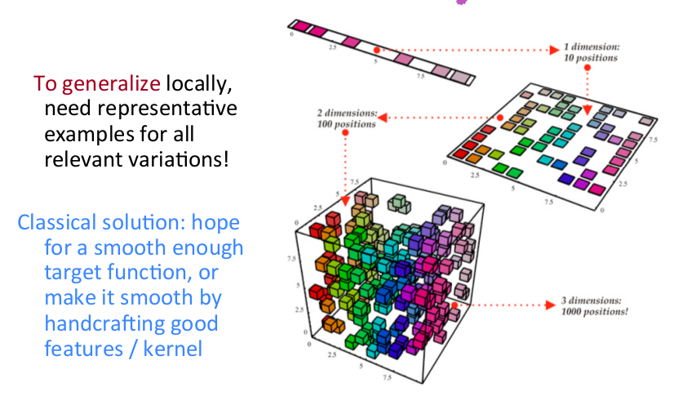
Why This Is Hard The Curse Of Dimensionality

Slide 43
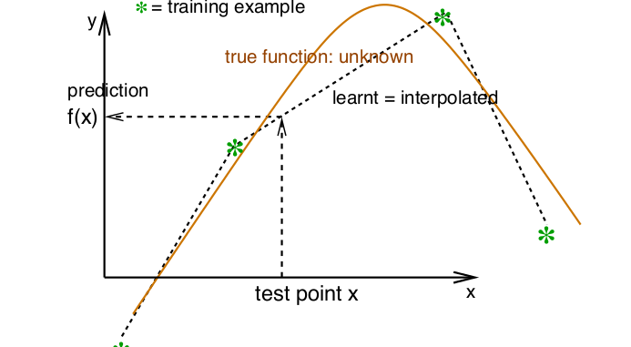
So What Is Smoothness?
Smoothness assumption: If x is geometrically close to x’ then f(x) ≈ f(x’)

Slide 44
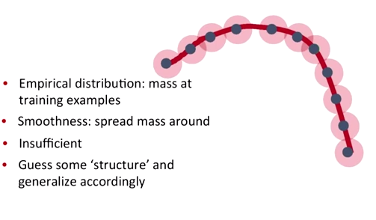
Smoothness, basically…
Probability mass P(Y=c|X;θ)

Slide 45
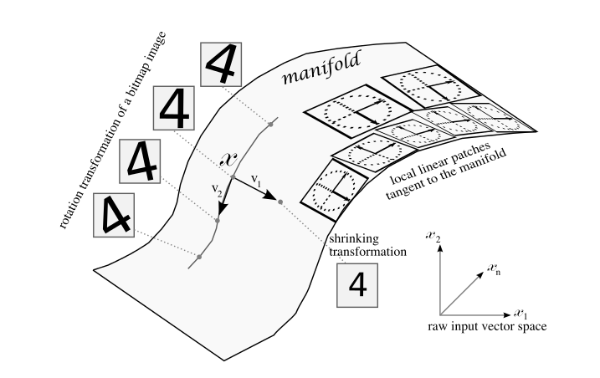
Manifold Hypothesis
BTW, you can demonstrate the MH to yourself
with a simple thought experiment on image data…
The Manifold Hypothesis states that natural data forms lower dimensional manifolds
in its embedding space. Why should this be? Well, it seems that there are both
theoretical and experimental reasons to suspect that the Manifold Hypothesis is true.
So if you believe that the MH is true, then the task of a machine learning classification
algorithm is fundamentally to separate a bunch of tangled up manifolds.

Slide 46
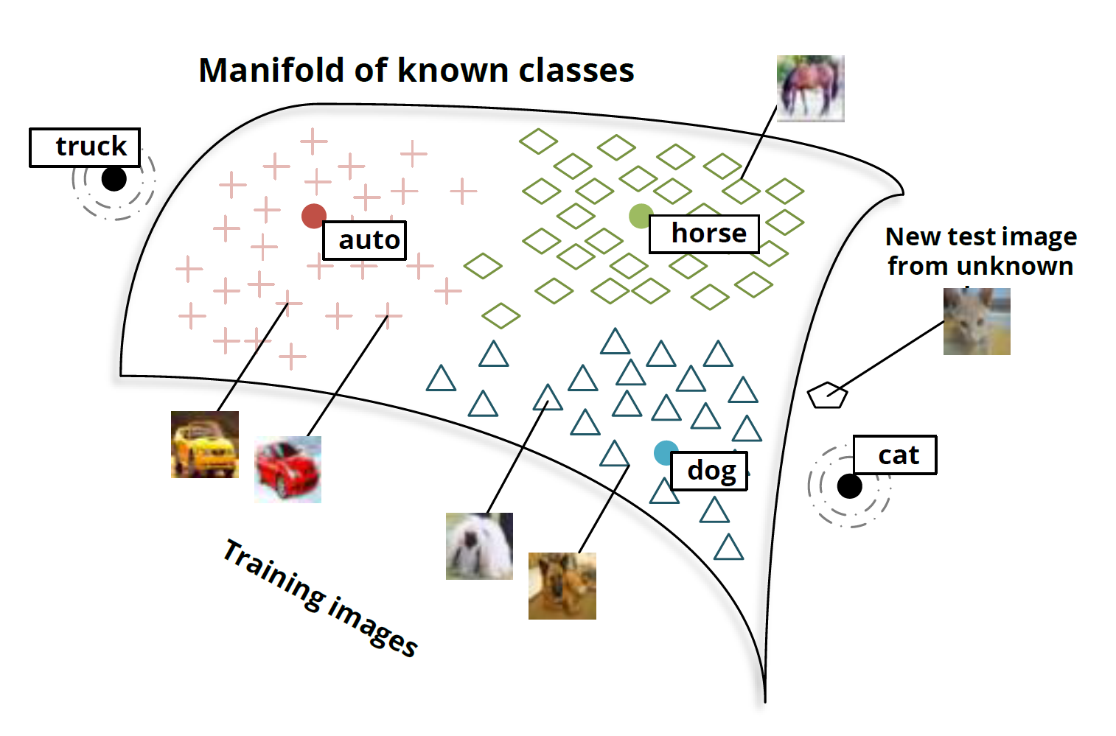
Manifolds and Classes

Slide 47
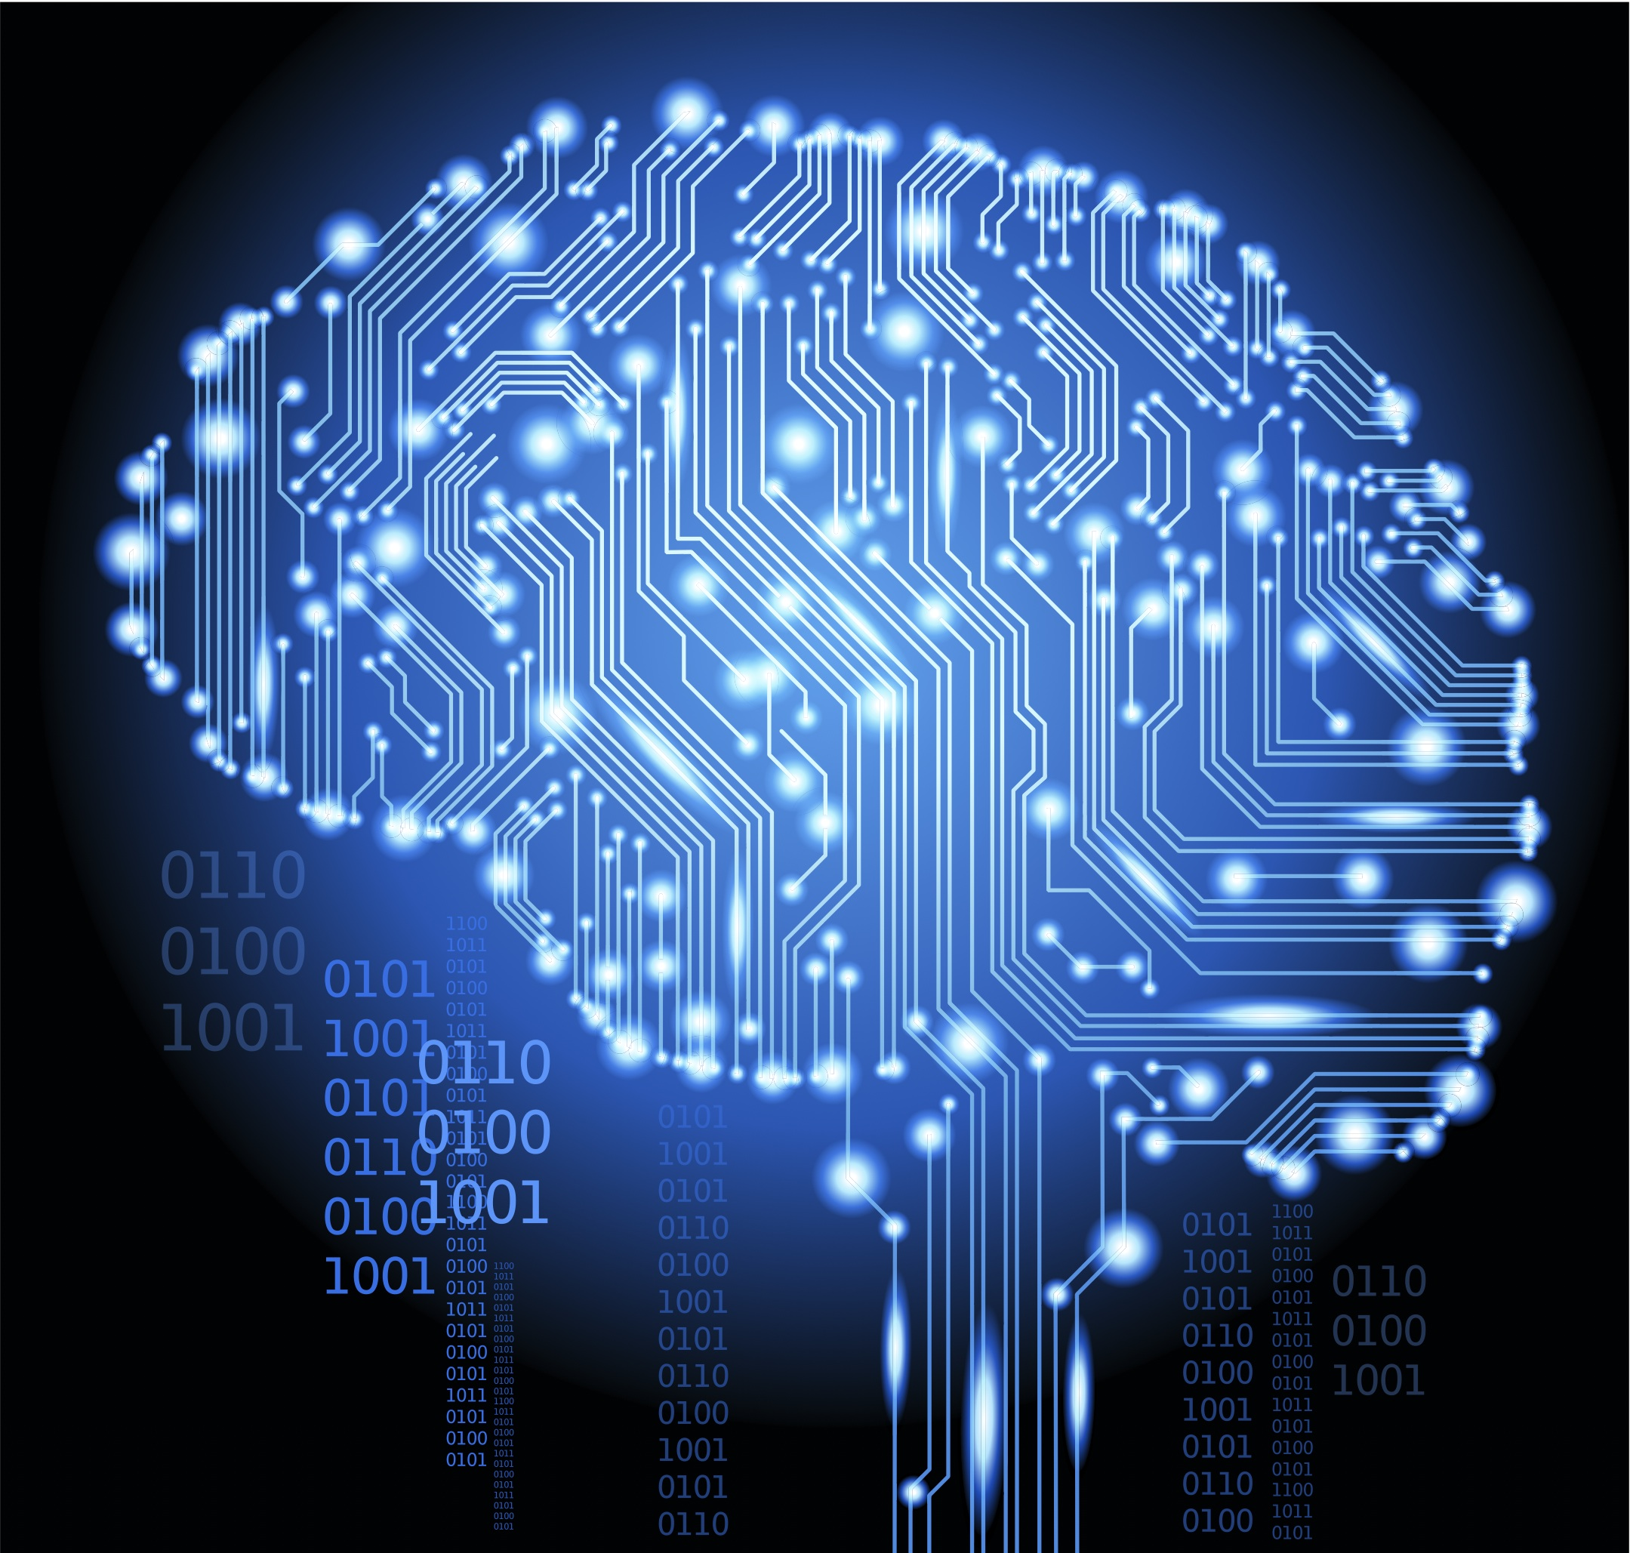
Backup

